Slide 1
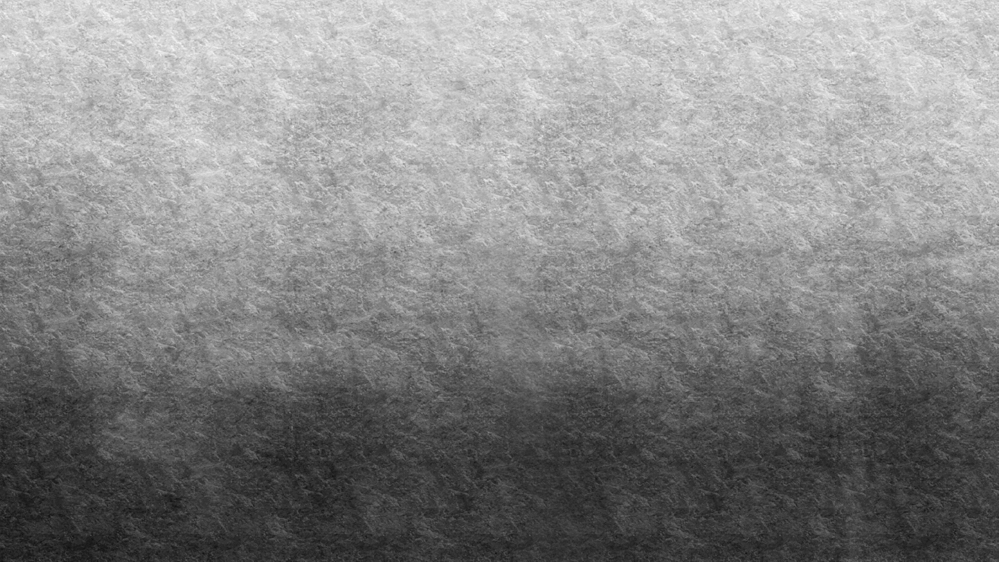

NFT en OpenSea https://opensea.io/assets/ethereum/0x495f947276749ce646f68ac8c248420045cb7b5e/74677104591473754178833890695516532960852815263250272955916215535426940698625/

Slide 2
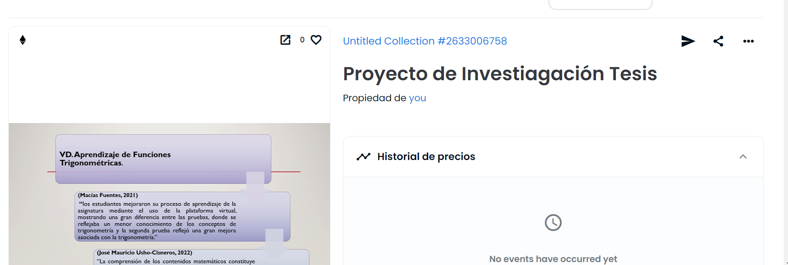

Slide 3
